Slide 1
Why Hanging and Autonomous Will Win us State

Slide 2
The Opitons
Reliability
Improved block collection
Double hanging
60 point autonomous

Slide 3
Reliability Point Breakdown
Reliability is defined as
Making the robot no longer prone to any disconnection of any type
Giving all subsystems a 100% success rate
Points lost based on disconnection
We have suffered from disconnection 5 times in the 35 matches we have played
Only three can be solved by reliability as defined by this: the other two were human error
In these three matches we were still able to score auto and hang, resulting in a loss of only points from blocks
35: average score from blocks for our robot
Average points lost by robot over time by reliability failure
35 / 35 * 3 = 3
Points lost by failed subsystem
In a game, we have never failed to dispense an auto block and get on the ramp
We have never failed to hang
We have never failed to raise the flag

Slide 4
Block collector point breakdown
The block collector has the potential to gain points
We don’t have historic success with it
This is because the goal is not linear: we don’t know what we have to do to make it work better
Both times we have voted to modify if we have tried to make drastic changes and failed
We have had to throw something together the night before
The time to success ratio is far from optimal
In the last month and a half of work on the block collector, the trips have not improved, but the average block collection rate has risen form 2.5 to 3.5 blocks per trip
We consistently make 4 trips in the 1:30 minute main game period
Projected score has changed from 45 to 63 in a month and a half
Every week we have worked on it we have gained three more points per game on average

Slide 5
Double hanging point breakdown
At the state level, it is same to assume that most qualifying robotics will be able to hang, and some hang and raise the flag.
All robots can raise the flag or hang
2/3 will be able to hang
1/3 will be able to raise flag and hang
Half of bots that can raise the flag and hang will be able to do them both in the end game
If we don’t do double hanging, we will score 85 in the end game every time
If we do, the average end game score will be 101

Slide 6
Autonomous
Assumptions
½ the time we push a robot off the ramp
1/3 of the time we halfway on the ramp
2/3 of the time we get all the way on the ramp
We always score the block
¼ of the time we score the IR
As is, we get an average of 46 points
If we took the time to implement the accelerometer, we could double the speed at which we score, putting us ahead of any other robot and always on the ramp
This same technology would also help us detect when we have traveled over the top of the ramp
This means we could push adversaries half of the way off the ramp every time, by applying power until we detect going half way over.
The net point gain of the new autonomous would be 55 points per match

Slide 7
The different point values gained
Reliability : 3
Block collector : 6
Gyro and accelerometer autonomous : 9
Double hanging : 16
Still think that reliability and Block collection will win us state?
The numbers don’t lie: If we stick to that game strategy we will plateau while other teams improve rapidly

Slide 8
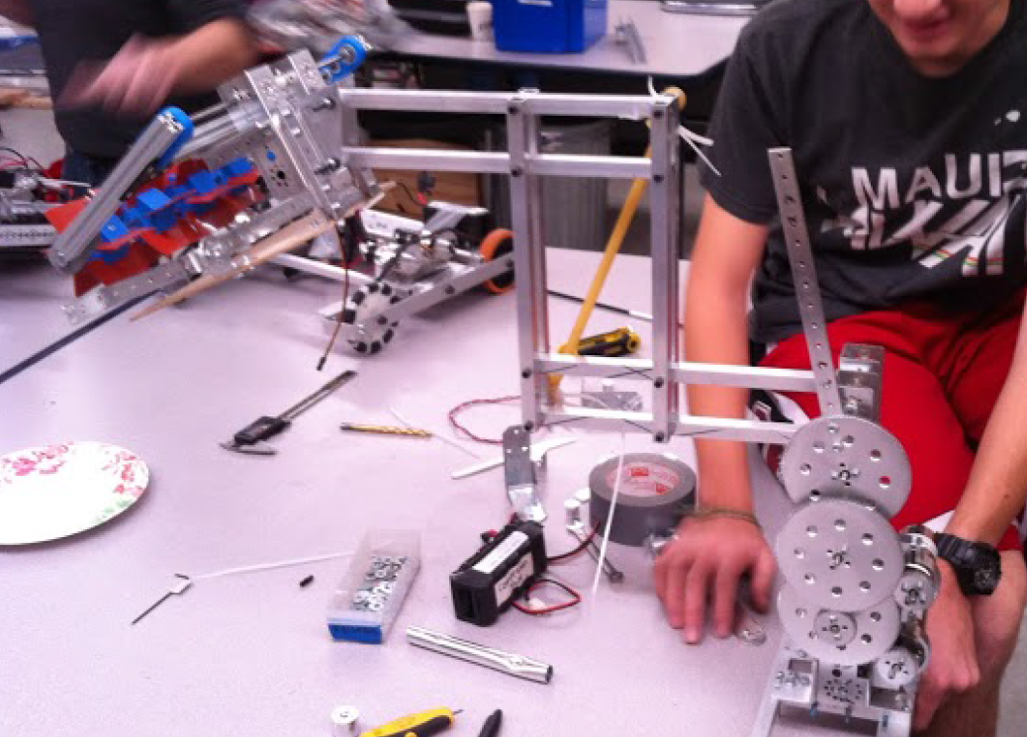
Double Hanging Idea
Double hanging would be achieved by extending a reinforced bar off of our robot for another to hang on
This would not put any more weight on our arm mechanism
It would actually make it easier for us to hang, by compressing the arm
I am not set on this mounting or even sure if this location will work, but the idea I know is very feasible

